Slide 1



DALEELAK
AI QUEST 2026 · Smart Society & Public Services
دليلك
An AI guide that understands the situation of the citizen and turns all his needs into a series of mandatory procedures at government service centers formed as a clear plan: what to do, what to bring and where to go.
your guide
Microslop · Ward Saleh · Ameen Sonjuq · Ahmad Odeh · Ali Shqair · Eyas Dmour · October 2026
Notes:
Open with the one-line idea: DALEELAK, Arabic for "your guide", helps people describe what they need in everyday language and walks them through the documented procedure step by step. Fill in team and presenter names before presenting.

Slide 2





People know what went wrong
They rarely know which procedure fixes it
THE PROBLEM
Formal language
Hidden requirements
Steps and places
Service names and official terms don't match how people describe their situation in everyday Jordanian Arabic.
Which documents, originals or copies, which fees and commitments: details are spread across guides and service cards.
Prerequisites come first and may need a different office. Getting the order wrong means another trip.
DALEELAK · 02
Notes:
Frame the pain without inventing statistics: the issue is uncertainty about what to do, what to bring and where to go. Example: replacing a lost family book needs a police loss report before the service itself.

Slide 3



Say it in your own words
Get a plan you can follow
THE SOLUTION
The citizen says
DALEELAK returns
ضاع دفتر العيلة، شو أعمل؟
A few questions that change the route
Ordered steps
Checklists for all steps
Progress saved on the phone
"I lost the family book, what do I do?"
DALEELAK · 03
Notes:
DALEELAK means "your guide". The user describes the problem in everyday Arabic, English or a mix; the assistant only asks what changes the documented route, then hands back a plan.

Slide 4
Five small steps into a clear organized solution
HOW IT WORKS
1
2
3
4
5
Ask
Clarify
Plan
Execution
Track
Receives a voice or text input in Jordanian Arabic, English or both. The transcript stays editable before sending.
Only questions that change the route: lost or damaged, inside Jordan or abroad, steps already done.
Snapping step cards. The first card groups every task you can start right now.
Checklists for documents, actions, payments and visits, plus up to three nearby places.
Save and resume later. Operations sit in new, ongoing or completed.
DALEELAK · 04
Notes:
Walk left to right. Stress that browsing future cards never marks them done or skips prerequisites, and that progress is user-reported because there is no government status feed.

Slide 5
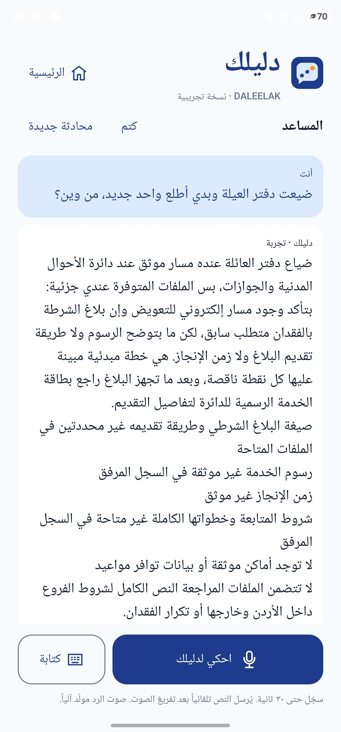


Replacing a lost family book
PILOT JOURNEY
تعويض دفتر عائلة مفقود
Describe a first, local loss in Arabic
Answer one relevant question and confirm the summary
Open a step with its checklists and nearby options
Save, leave, and resume at the next action
Change an answer and see requirements update
Mark progress, then complete or reopen
DALEELAK · 05 · Screenshot: Android build, 10 Oct 2026
Notes:
The pilot follows a Jordanian citizen replacing a lost family book, grounded in the CSPD electronic service card. The screenshot shows the partial plan: the police-report prerequisite and the electronic route are confirmed, and the missing details are listed openly instead of guessed.

Slide 6


The AI interprets. Reviewed sources decide.
TRUST BY DESIGN
The AI model
The app
Understands everyday Jordanian Arabic
Picks only questions that change the route
Maps answers to reviewed conditions
Returns a fixed JSON shape, not free prose
Validates every claim against source IDs
Owns progress, history and map links
Never confirms a government approval
When sources don't cover something, DALEELAK says so instead of guessing.
Notes:
This is the key differentiator for judges. Government guidance comes only from reviewed records such as the CSPD service card and 2024 services guide. The model never invents fees, formats, locations or outcomes, and it does not build a personal profile.

Slide 7
SCALING UP
Two ways to reach every citizen
PATH A
PATH B
An extension inside Sanad
A standalone national platform
Meets citizens in the app they already use
Reuses Sanad sign-in, booking and e-services
DALEELAK becomes the guide layer on top
Needs a MoDEE partnership and API access
An officially approved guide for all services
Covers in-person procedures, not only online ones
Links out to Sanad and service centres
Needs government approval and official data
Same core either way: reviewed sources, AI interpretation and exact app logic.
DALEELAK · 12 · MoDEE's AI implementation plan already proposes conversational and voice features for Sanad
Notes:
[~25 s] This answers the scalability question directly. Either path works because the core does not change. Mention that MoDEE's published AI implementation plan proposes conversational and voice features for Sanad, so DALEELAK fits a direction the government has already described. Do not claim a partnership exists.

Slide 8



Less guessing about what to do, what to bring and where to go.
Thank you. We'd love your questions and a few minutes of feedback after the demo.
Microslop · Ward Saleh · Ameen Sonjuq · Ahmad Odeh · Ali Shqair · Eyas Dmour · October 2026
Notes:
Close on the intended outcome, phrased as intent rather than a measured result: less uncertainty for citizens. Then invite questions and show the live demo if not already done.

